Slide 1
Poles, Zeroes, S-Plane Plot, and Stability.
Linear Circuit Analysis II
EECE 202 – Spring 2025

Slide 2
Announcement
PD 1 Voice Over PPT due in Week 10
GCA2 – Group Week 11 Lecture 2

Slide 3
Recap
Active vs passive filters
Types of active filters
Butterworth filter
New Material
Transfer function revision
Stability in s-plane
Effect of pole location

Slide 4
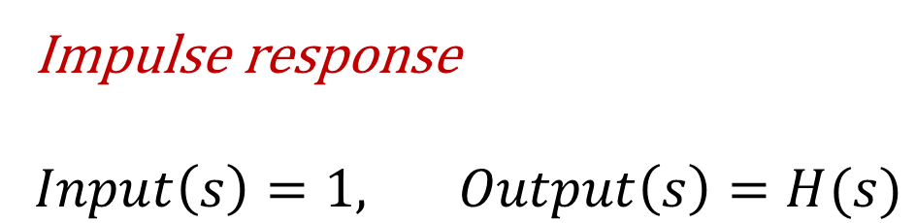
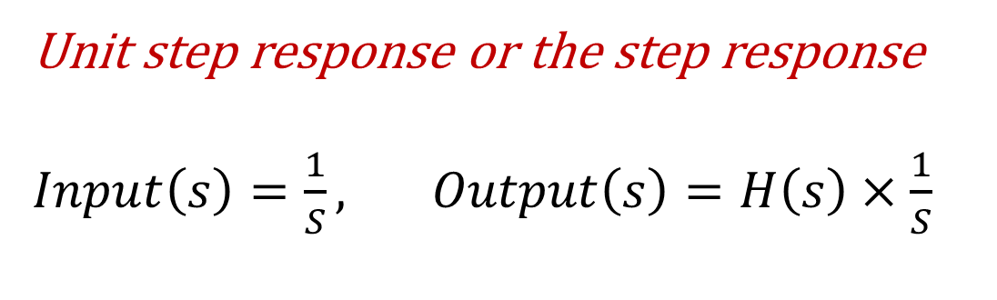
Revision (Transfer functions)
$$H\left(s\right)=\frac{Output(s)}{Input(s)}$$
$$Output\left(s\right)=H\left(s\right)×Input(s)$$
Impulse response
$Input\left(s\right)=1, Output\left(s\right)=H(s)$
Unit step response or the step response
$Input\left(s\right)=\frac{1}{S}, Output\left(s\right)=H\left(s\right)×\frac{1}{S}$

Slide 5
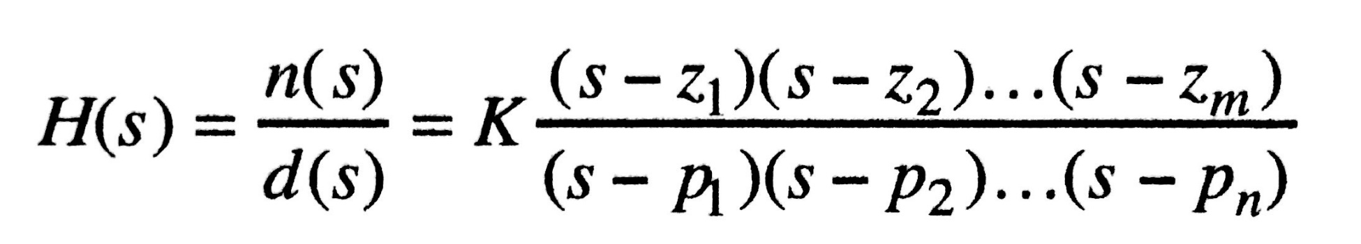
Transfer functions
As defined, the transfer function is a rational function in the complex variable s = σ + jω, that is
….(1)
It is often convenient to factor the polynomials in the numerator and denominator, and to write the transfer function in terms of those factors:
….(2)

Slide 6
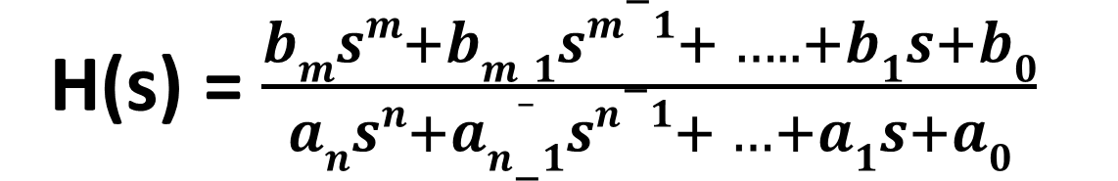
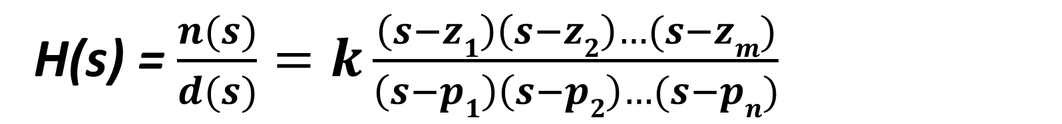
salman
Transfer functions
As defined, the transfer function is a rational function in the complex variable s = σ + jω, that is
H(s) = $\frac{bmsm+bm_1sm−1+ ….. +b1s+b0}{ansn+an−1sn−1+ …+a1s+a0}$
….(1)
It is often convenient to factor the polynomials in the numerator and denominator, and to write the transfer function in terms of those factors:
H(s) = $\frac{n(s)}{d(s)}=k\frac{\left(s−z1\right)\left(s−z2\right)…(s−zm)}{\left(s−p1\right)\left(s−p2\right)…(s−pn)}$
….(2)

Slide 7

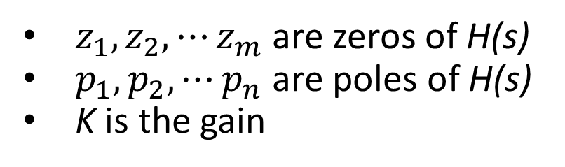


Transfer functions cont.
Zeros
Poles
$z_{1},z_{2}, ⋯z_{m}$ are zeros of H(s)
$p_{1},p_{2}, ⋯p_{n}$ are poles of H(s)
K is the gain
s-plane.
$$Im\left\{s\right\}=jω$$
$$Re\left\{s\right\}=σ$$

Slide 8
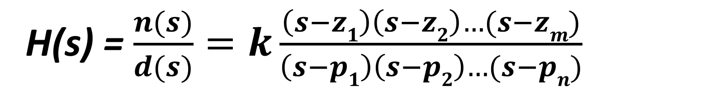
salman
Transfer functions cont.
H(s) = $\frac{n(s)}{d(s)}=k\frac{\left(s−z1\right)\left(s−z2\right)…(s−zm)}{\left(s−p1\right)\left(s−p2\right)…(s−pn)}$
Zeros
Poles
$z_{1},z_{2}, ⋯z_{m}$ are zeros of H(s)
$p_{1},p_{2}, ⋯p_{n}$ are poles of H(s)
K is the gain
s-plane.
$$Im\left\{s\right\}=jω$$
$$Re\left\{s\right\}=σ$$

Slide 9
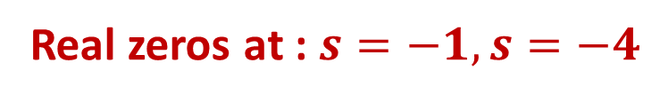


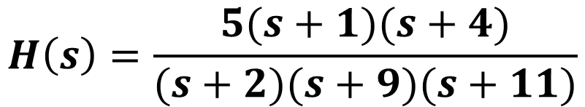



Transfer functions cont.
Example
Find zeros and poles for the following transfer function, map poles and zeros on s-plane.
$$H\left(s\right)=\frac{5(s+1)(s+4)}{(s+2)(s+9)(s+11)}$$
Real zeros at : $s=−1, s=−4$
Real poles: $s=−2, s=−9, s=−11$
$$jω$$
$$σ$$

Slide 10
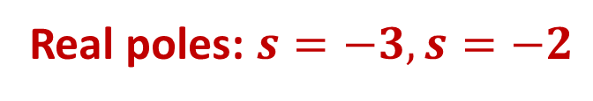

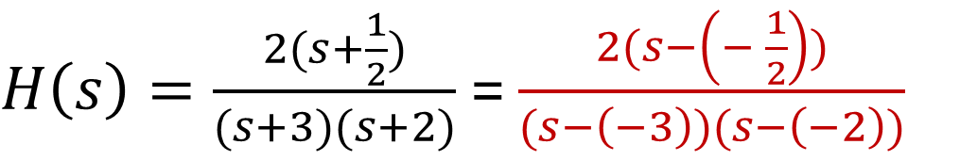
Example -1
Determine the zeros and poles for the following transfer function:
The given transfer function can be rewritten as
$H\left(s\right)=\frac{2(s+\frac{1}{2})}{(s+3)(s+2)}$ = $\frac{2(s−\left(− \frac{1}{2}\right))}{(s−\left(−3\right))(s−\left(−2\right))}$
Real zero at : $s=−\text{1/2}$
Real poles: $s=−3, s=−2$

Slide 11
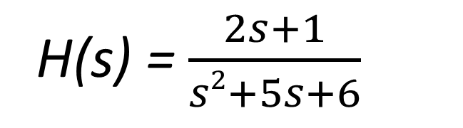
salman
Example -1
Determine the zeros and poles for the following transfer function:
H(s) = $\frac{2s+1}{s2+5s+6}$
The given transfer function can be rewritten as
$H\left(s\right)=\frac{2(s+\frac{1}{2})}{(s+3)(s+2)}$ = $\frac{2(s−\left(− \frac{1}{2}\right))}{(s−\left(−3\right))(s−\left(−2\right))}$
Real zero at : $s=−\text{1/2}$
Real poles: $s=−3, s=−2$

Slide 12

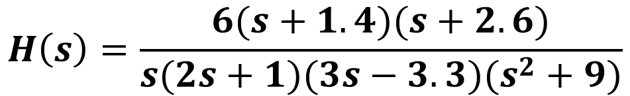
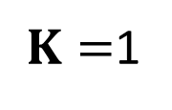
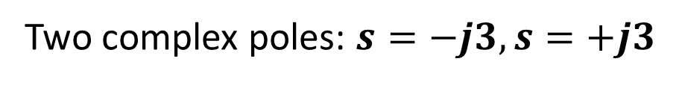
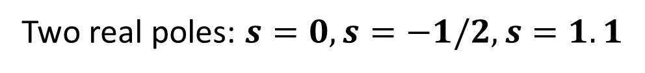
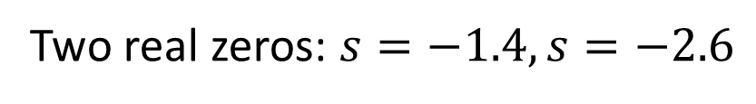

Example -2
Find K, zeros and poles for the following transfer function, map the poles and zeros on s-plane.
$$H\left(s\right)=\frac{6(s+1.4)(s+2.6)}{s(2s+1)(3s−3.3)(s^{2}+9)}$$
Solution:
$$jω$$
Two real zeros: $s=−1.4, s=−2.6$
Two real poles: $s=0, s=−1/2, s=1.1$
Two complex poles: $s=−j3, s=+j3$
$$σ$$
$K=$1

Slide 13
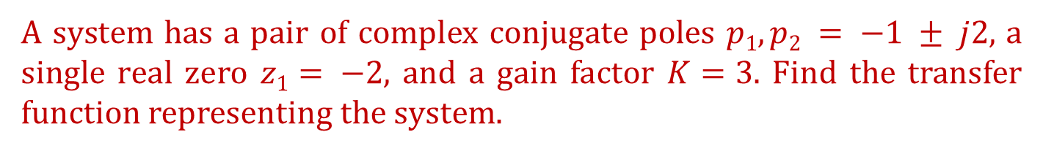
Example -3
A system has a pair of complex conjugate poles $p1, p2 = −1 ± j2$, a single real zero $z1= −2$, and a gain factor $K=3$. Find the transfer function representing the system.
The transfer function is
2
2)
Note: $\left(s−(−1+ j2)\right)\left(s−(−1− j2)\right)={(s+1)}^{2}+2^{2}=s^{2}+2s+5$

Slide 14
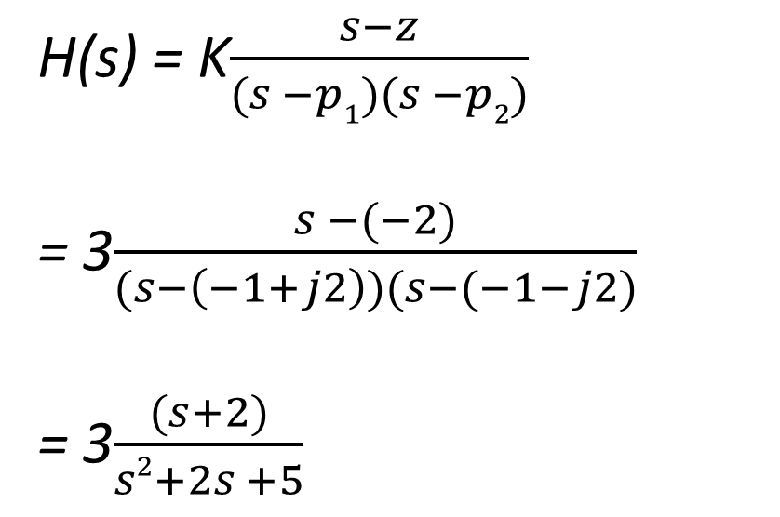
salman
Example -3
A system has a pair of complex conjugate poles $p1, p2 = −1 ± j2$, a single real zero $z1= −2$, and a gain factor $K=3$. Find the transfer function representing the system.
The transfer function is
H(s) = K$\frac{s−z}{(s −p1)(s −p2)}$
= 3$\frac{s −(−2)}{(s−\left(−1+j2\right))(s−(−1−j2)}$
= 3$\frac{(s+2)}{s2+2s +5}$
Note: $\left(s−(−1+ j2)\right)\left(s−(−1− j2)\right)={(s+1)}^{2}+2^{2}=s^{2}+2s+5$

Slide 15
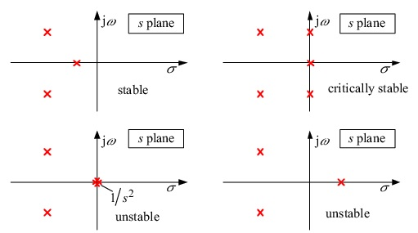
Stability in the S-plane (characterized by pole locations)

Slide 16
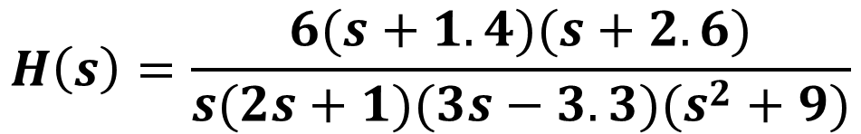
Example -4
Check the stability of the following systems.
$$H\left(s\right)=\frac{6(s+1.4)(s+2.6)}{s(2s+1)(3s−3.3)(s^{2}+9)}$$
System is unstable because of the pole at s=1.1
System is stable because all poles are at the LHP

Slide 17
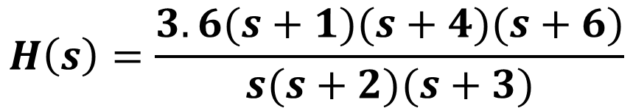
Example -5
Find the transfer function for the system that has poles at 0, -2 and -3 and zeros at -1, -4 and -6, note that H(1)=21. Check the stability of the system.
$$H\left(s\right)=\frac{3.6(s+1)(s+4)(s+6)}{s(s+2)(s+3)}$$
Critically Stable because two poles are negative and one at 0

Slide 18
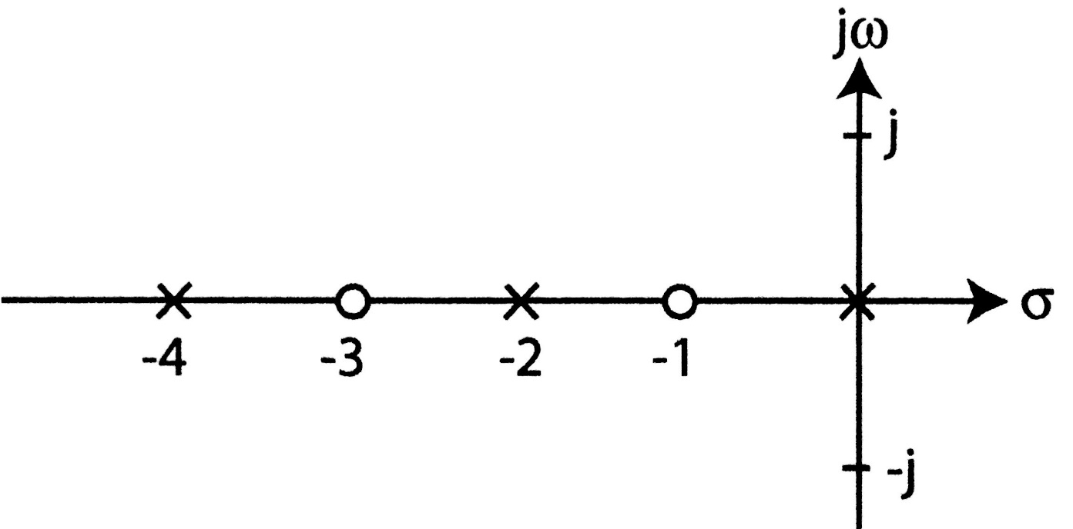
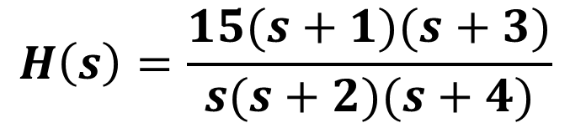
Example -6
Find the transfer function for the system that has poles and zeros shown in the figure, note that H(1)=8. Check the stability of the system.
$$H\left(s\right)=\frac{15(s+1)(s+3)}{s(s+2)(s+4)}$$
Critically Stable

Slide 19
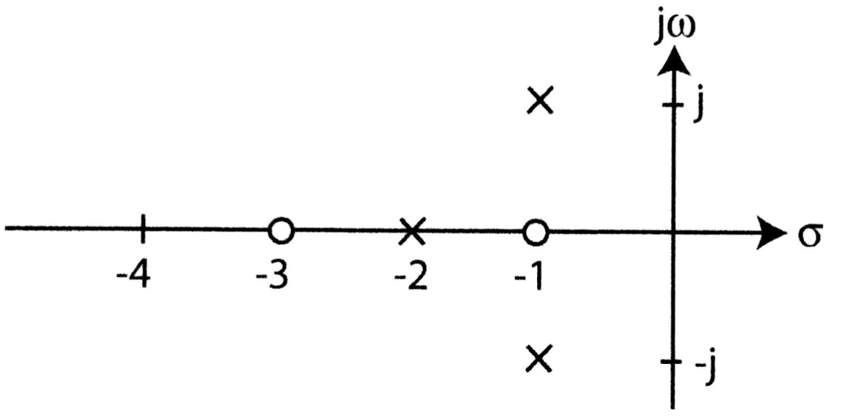
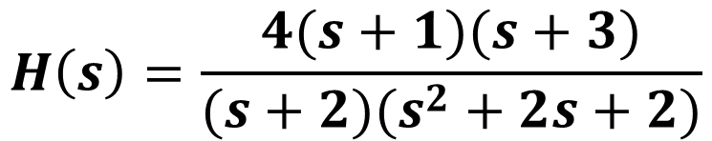
Example -7
Find the transfer function for the system that has poles and zeros shown in the figure, note that H(0)=3. Check the stability of the system.
$$H\left(s\right)=\frac{4(s+1)(s+3)}{(s+2)(s^{2}+2s+2)}$$
Stable

Slide 20

Example -8
Find H(s) in terms of a and b from the pole-zero plot below assuming H(0) = 5.
j$ω$
×
jb
-a
σ
×
-jb
5

Slide 21

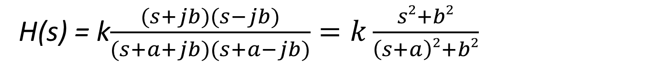
salman
Example - 8
Find H(s) in terms of a and b from the pole-zero plot below assuming H(0) = 5.
H(s) = k$\frac{(s+jb)(s−jb)}{(s+a+jb)(s+a−jb)}=k\frac{s2+b2}{\left(s+a\right)2+b2}$
j$ω$
×
jb
-a
σ
×
-jb
$$H\left(0\right)=5=K \frac{b2}{a2+b2} \overset{⇒}{} K=5 \frac{a2+b2}{b2}$$

Slide 22
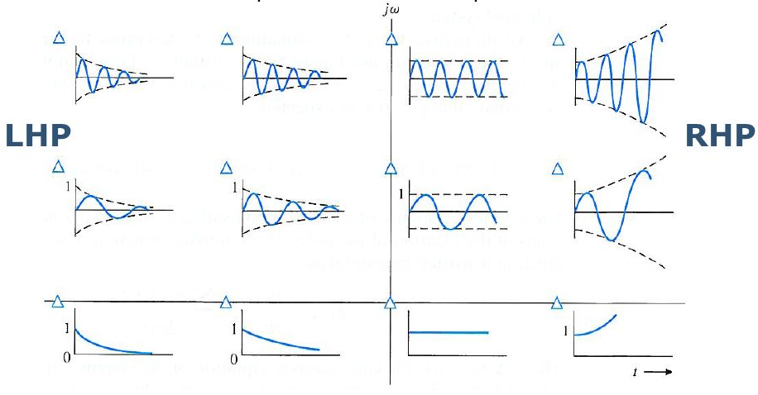
Effect of Pole Location on the Impulse Response

Slide 23


Example -9
Find the Range of “a” that achieves stability for the transfer function of the circuit shown.
By applying Nodal analysis
Node V_{out}
1Ω
V₁
1H
+
$$s V_{out}+V_{out}−V_{1}=0$$
V_{in}
+
a V_{out}
1Ω
Multiply by$s$
V_{out}
-
-
Eq. 1

Slide 24
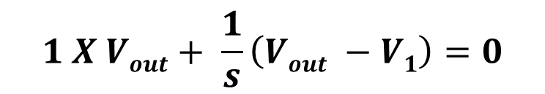
Example -9
salman
Find the Range of “a” that achieves stability for the transfer function of the circuit shown.
By applying Nodal analysis
Node V_{out}
$$1 X Vout+ \frac{1}{s}\left(Vout −V1\right)=0$$
1Ω
V₁
1H
+
$$s V_{out}+V_{out}−V_{1}=0$$
V_{in}
+
a V_{out}
1Ω
Multiply by$s$
V_{out}
-
-
(s+1)V_{out} = V₁
Eq. 1

Slide 25
Node V₁
$$s \left(V1−V_{in}\right)−asV_{out}+V1−V_{out}=0$$
$$Vout \left(as+1\right)−\left(s+1\right)V_{1}=−sV_{in}$$
Eq. 2
By substituting eq. 1 into eq. 2
$$Vout \left(as+1\right)−\left(s+1\right)2V_{out}=−sV_{in}$$
1Ω
V₁
1H
+
$$Vout\left(as+1−s2−2s−1\right)=−sV_{in}$$
V_{in}
+
a V_{out}
1Ω
-
V_{out}
-

Slide 26
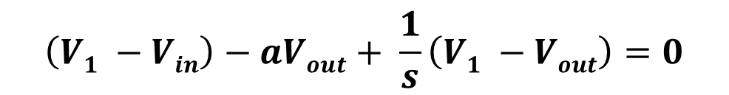
Node V₁
salman
$$\left(V1 −Vin\right)−aVout+ \frac{1}{s}\left(V1 −Vout\right)=0$$
$$s \left(V1−V_{in}\right)−asV_{out}+V1−V_{out}=0$$
$$Vout \left(as+1\right)−\left(s+1\right)V_{1}=−sV_{in}$$
Eq. 2
By substituting eq. 1 into eq. 2
$$Vout \left(as+1\right)−\left(s+1\right)2V_{out}=−sV_{in}$$
1Ω
V₁
1H
+
$$Vout\left(as+1−s2−2s−1\right)=−sV_{in}$$
V_{in}
+
a V_{out}
1Ω
-
V_{out}
-

Slide 27
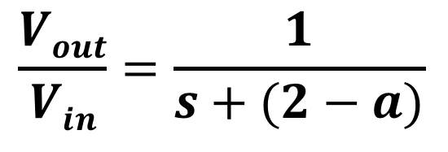

$$Vout\left(as−s2−2s\right)=−sV_{in}$$
$$Vout\left(a−s−2\right)=−V_{in}$$
$$\frac{Vout}{Vin}=\frac{1}{s+(2−a)}$$
For the system to be stable, (a-2)< 0, then a<2

Slide 28
$$Vout\left(as−s2−2s\right)=−sV_{in}$$
salman
$$Vout\left(a−s−2\right)=−V_{in}$$
$$\frac{Vout}{Vin}=\frac{1}{s+(2−a)}$$
$$H\left(s\right)= \frac{Vout}{Vin}= \frac{1}{s+2−a}$$
For the system to be stable, (a-2)< 0, then a<2

Slide 29
Answer the following questions using ChatGPT
Explain the physical significance of poles and zeros in a system.
How does the location of poles on the s-plane affect the system’s stability and response?
What does the s-plane represent in control system analysis?
Why is mapping poles and zeros onto the s-plane useful?
How does moving poles closer to the imaginary axis affect the system's response?

Slide 30
Suggested examples
Summary
Zeros: Values of s that make H(s)=0.
Poles: Values of s that make H(s)→∞.
Mapped on the s-plane to analyze system behavior.
Stability depends on pole locations:
Poles in the Left Half Plane (LHP): Stable.
Poles in the Right Half Plane (RHP): Unstable.
Poles on the imaginary axis: Critically stable.
Impulse response shape is influenced by pole location:
Closer to the origin: Faster response.
Farther from the origin: Slower response or oscillatory.
Page 685, example 14.1 Page 686, example 14.2
Page 687, exercise Page 742, examples: 3, 5
Page 745, examples: 16, 17, 18

